Slide 1


PWA in Action
ngVikings
2nd , March 2018
Majid Hajian

Slide 2



Passionate web developer
Open Source lover and contributor
Public speaker, Organizer
Packt Publishing Instructor
MAJID HAJIAN
@mhadaily

Slide 3
Progressively Improve User Experience

Slide 4
Content Overview
App Banner Prompt
Show app banner prompt
when it’s the best time.
Background Sync
Let’s save user data
and sync back with server
Better App Theme
Give your user the best experience
with progressive enhancement
Cache Strategies
Dive into cache strategies and understating
How they works

Slide 5

BANNER
PROMPT

Slide 6
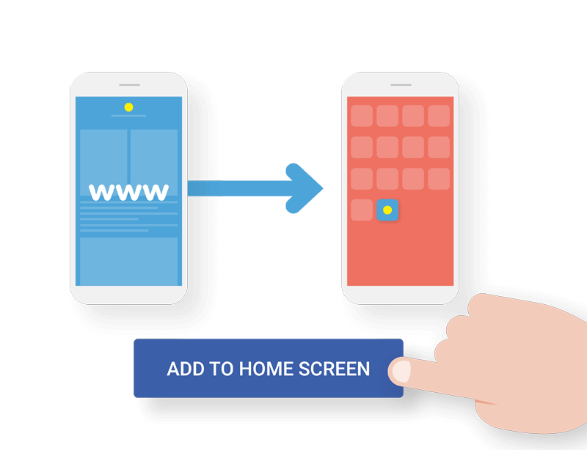
Installable

Slide 7
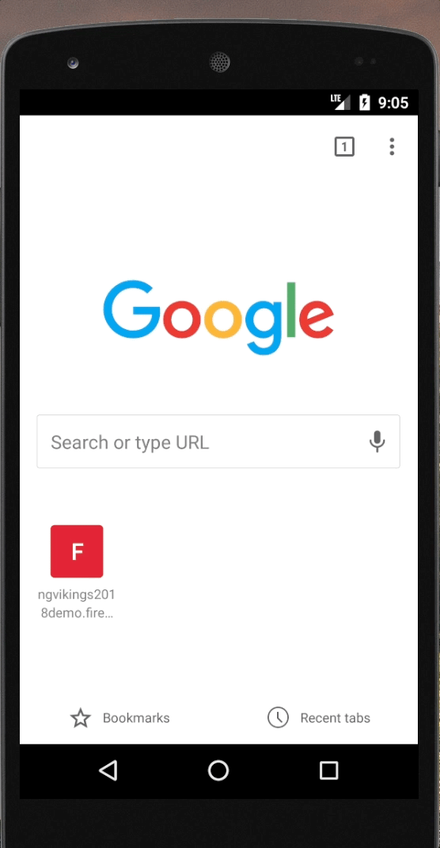
deferredPrompt(event) {
event.preventDefault();
this.deferredPromptEvent = event;
return false;
}

Slide 8
async ShowDefferedPrompt() {
if (this.deferredPromptEvent) {
(<any>this.deferredPromptEvent).prompt();
const choice = await this.deferredPromptEvent.userChoice;
if (choice.outcome === 'dismissed') {
console.log('installation was cancelled By User');
} else {
console.log('User added to home screen');
}
this.deferredPromptEvent = null;
}
}

Slide 9

Better
App Theme

Slide 10
renderer.listen('window', 'online', (e) => this.backOnline(e));
renderer.listen('window', 'offline', (e) => this.goesOffline(e));

Slide 11
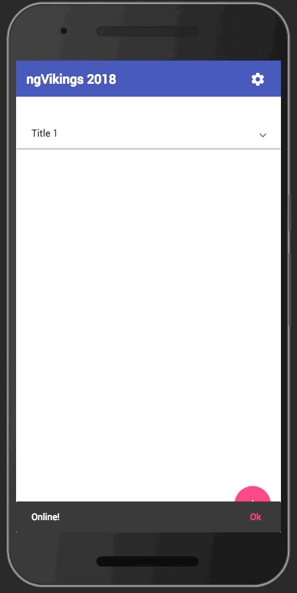
backOnline(e) {
this.snackBar.dismiss();
this.snackBar.open('Online!', 'Ok', { duration: 4000 });
(document.querySelector('body') as any).style = '';
}
goesOffline(e) {
this.snackBar.dismiss();
this.snackBar.open('Offline!', 'Ok', { duration: 4000 });
(document.querySelector('body') as any)
.style = 'filter: grayscale(1)';
}

Slide 12
@HostBinding('class') componentCssClass;
NIGHT_MODE_THEME = 'black-theme';
LIGHT_MODE_THEME = 'light-theme';
removeClasslist() {
const classList = this.overlayContainer.getContainerElement().classList;
const toRemove = Array.from(classList).filter((item: string) =>
item.includes('-theme')
);
classList.remove(...toRemove);
return classList;
}
setNightMode() {
this.componentCssClass = this.NIGHT_MODE_THEME;
this.removeClasslist().add(this.NIGHT_MODE_THEME);
}
setLightMode() {
this.componentCssClass = this.LIGHT_MODE_THEME;
this.removeClasslist().add(this.LIGHT_MODE_THEME);
}

Slide 13
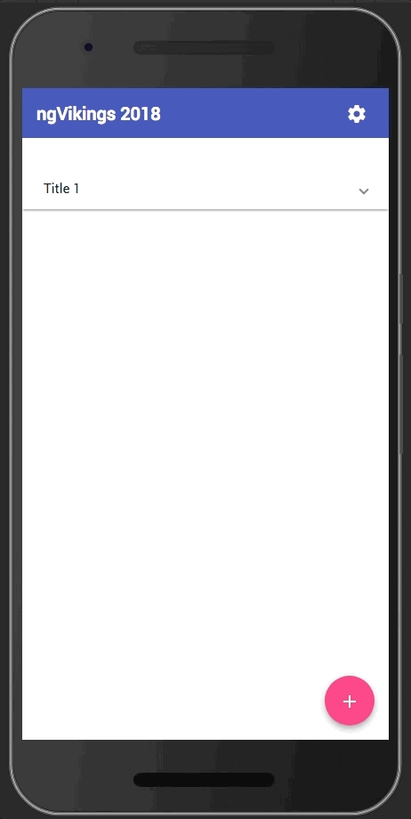
const hours = new Date().getHours();
if (hours >= 20 || hours <= 6) {
this.setNightMode();
} else {
this.setLightMode();
}
Generic Sensors API
Ambient Light API

Slide 14

BACKGROUND
SYNC
+ OFFLINE STORAGE

Slide 15






Connectivity Re-established
Sync event fires
Background Sync task
Database: IndexedDB, PouchDB, Cache API

Slide 16
BACKGROUND_SYNC_SAVE = 'sync-notes’;
registerTagSync(data) {
if ('serviceWorker' in navigator && 'SyncManager' in window) {
navigator.serviceWorker.ready
.then((sw) => {
// write to indexedDB
this.db.write(data)
.then(() => {
this.snackBar.open('successfully saved to local db!', 'Ok', { duration: 1000 });
// Register your tags
return sw.sync.register(BACKGROUND_SYNC_SAVE);
});
});
}
}

Slide 17
CONNECTIVITLY RE-ESTABLISHED

Slide 18
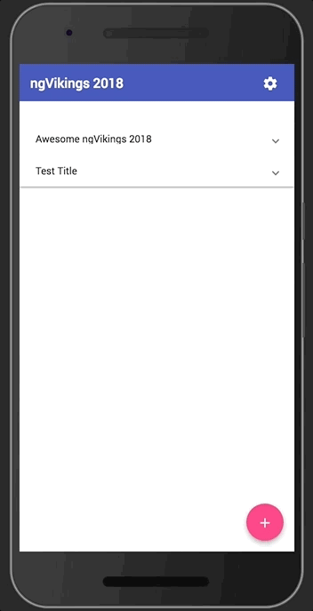
self.addEventListener('sync', function (event) {
console.log('[SW] Background syncing', event);
// you can define as many tag as you want
if (event.tag === BACKGROUND_SYNC_SAVE) {
console.log('[SW] Syncing new notes');
event.waitUntil(
db.readAll()
.then(function (data) {
data
.filter(note => !note.synced)
.map(note => {
sendData(note);
});
})
);
}
});

Slide 19
SERVICE WORKER
ngsw-worker.js
importScripts('/assets/js/libs/idb.min.js');
importScripts('/assets/js/libs/idb.min.js', '/assets/js/firebase.js');

Slide 20


OFFLINE STORAGE
IndexedDB
Cache Storage

Slide 21
import * as PouchDB from "pouchdb";
export class DbService {
private pouch: any;
constructor() {
this.pouch = new PouchDB('ngVikings2018Demo');
}
public addNote(title: string): Promise<string> {
const promise = this.pouch
.put({
_id: ('note:' + (new Date()).getTime()),
title: title
})
.then( (result: any): string => result.id);
return (promise);
}
}

Slide 23
const sync = PouchDB.sync(src, target, [options])
1-
PouchDB.replicate(
'ngVikings2018Demo', 'http://remoteserver:5984/ngVikings2018Demo');
PouchDB.replicate(
'http://remote:5984/ngVikings2018Demo', 'ngVikings2018Demo');
2- PouchDB.sync(
'ngVikings2018Demo',
'http://remote:5984/ngVikings2018Demo’
);

Slide 24

Cache
Strategies

Slide 25
FETCH EVENT
self.addEventListener('fetch',
(event) => {
console.log('[SW] Fetch ....');
const request = event.request;
event.respondWith()
}

Slide 26
Cache only
event.respondWith(
caches.match(request)
);

Slide 27
Network only
event.respondWith(
fetch(event.request)
);

Slide 28
Cache first, falling back to network
event.respondWith(
caches.match(request).then( (res) => {
return res || fetch(request).then( (newRes) => {
caches.open(DYNAMIC_CACHE_VERSION)
.then( cache => cache.put(request, newRes) );
return newRes.clone();
});
})
);

Slide 29
Network first, falling back to cache
event.respondWith(
fetch(request)
.then((res) => {
caches.open(DYNAMIC_CACHE_VERSION)
.then(cache => cache.put(request, res));
return res.clone();
}) // Fallback to cache
.catch(err => caches.match(request))
);

Slide 30
Cache with Network Update
event.respondWith(
caches
.match(request).then((res) => {
const updatedResopnse = fetch(request).then((newRes) => {
cache.put(request, newRes.clone());
return newRes;
}); return res || updatedResopnse;
})
);

Slide 31
Cache & Network Race
const promiseRace = new Promise((resolve, reject) => {
let firstRejectionReceived = false;
const rejectOnce = () => {
if (firstRejectionReceived) {
reject('No response received.');
} else {
firstRejectionReceived = true;
}
};
fetch(request)
.then(res => res.ok ? resolve(res) : rejectOnce())
.catch(rejectOnce);
caches.match(request)
.then(res => res ? resolve(res) : rejectOnce())
.catch(rejectOnce);
});
event.respondWith(promiseRace);

Slide 32

WHAT
ELSE…

Slide 33
Payment Request API
allows Web applications to delegate the payment
checkout process to the operating system,
allowing it to use whatever methods and payment providers
are natively available for the platform and configured for the user.
Page Visibility API
The Page Visibility API is useful for the Web application
to know whether it is currently displayed on the front or not
Vibration API
Give your user the best experience
with progressive enhancement
Battery Status
The Battery Status API allows Web applications
to get the information about the device's power source,
battery charge level, expected time of charging or discharging.
Credential Management
The Credential Management API allows authorized
Web applications to store and request user credentials
(like login and password or federated login data)
programmatically on behalf of the user.The API offers
a replacement for browser built-in or 3rd-party password stores
Push Notification
Push Messaging is the well-known re-engagement
mechanism from the mobile platforms

Slide 34
DEMO TIME

Slide 35
THANK YOU
See You Next Time
MAJID HAJIAN
@mhadaily

